Slide 1
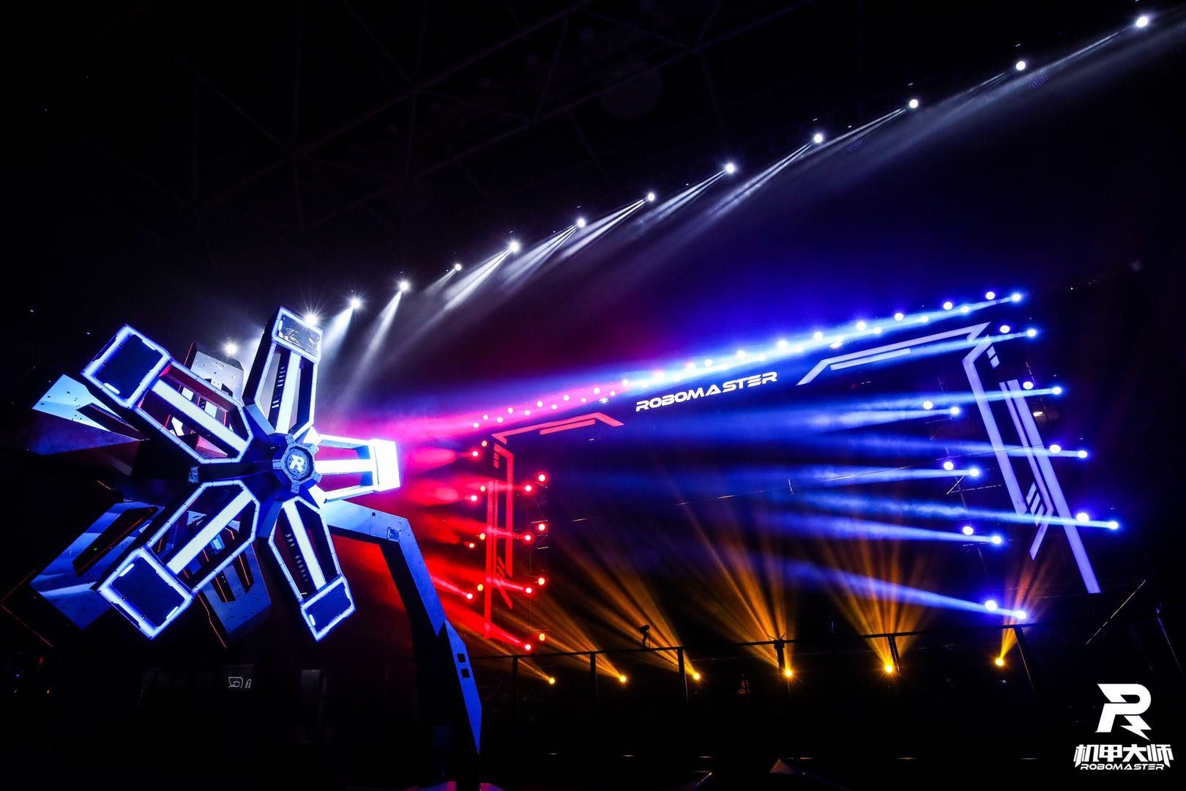
Power Rune
Dipu Chowdhury, Yuehan Dong, & Tahmeed Chowdhury

Slide 2
Task Description
Teams now need to program their robots to auto aim and hit a sequence of spinning targets in the new windmill style 'Power Rune'.
Only increases base damage and that given by the primary attribute of the affected hero. Raw bonus damage is not increased.
The hero's current main damage is checked periodically, and the bonuses adapted instantly.

Slide 3
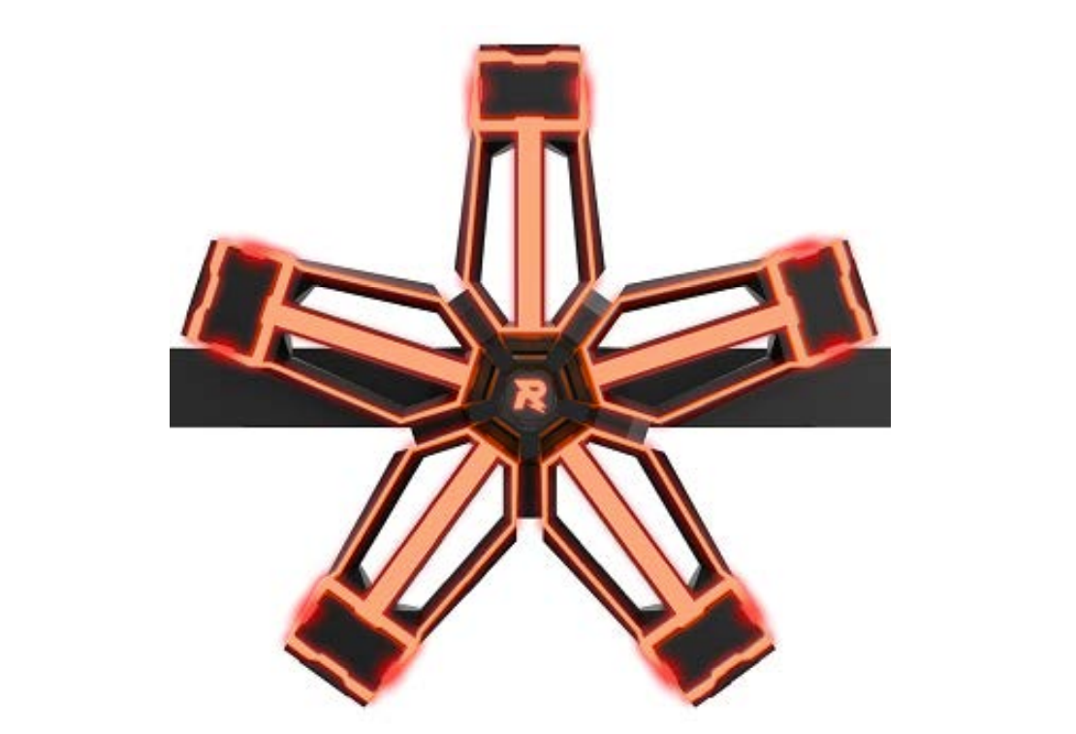
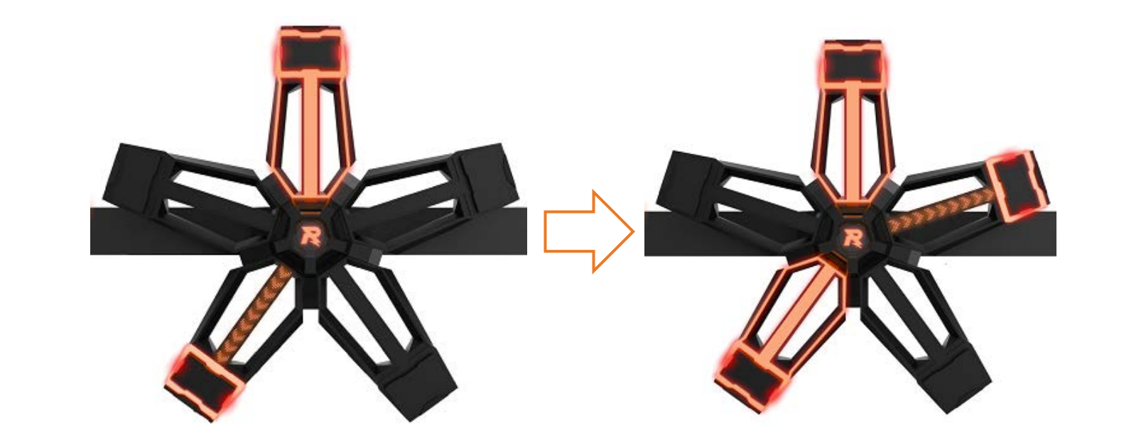
About the Power Rune
Direction of the spin is random
Speed is 10 RPM (Rounds-Per-Minute)
Has 5 armour modules
Need to hit the indicated (lit up on the inside) module
Once hit, the outside will light up as well
2.5 seconds to hit illuminated module
All 5 need to be lit to get the boost
If wrong panel is hit, you must restart
https://rm-static.djicdn.com/tem/19806/RoboMaster%202019%20Technical%20Challenge%20Rules%20Manual%20V2.1%20(20190725).pdf

Slide 4
Resources

